Slide 1
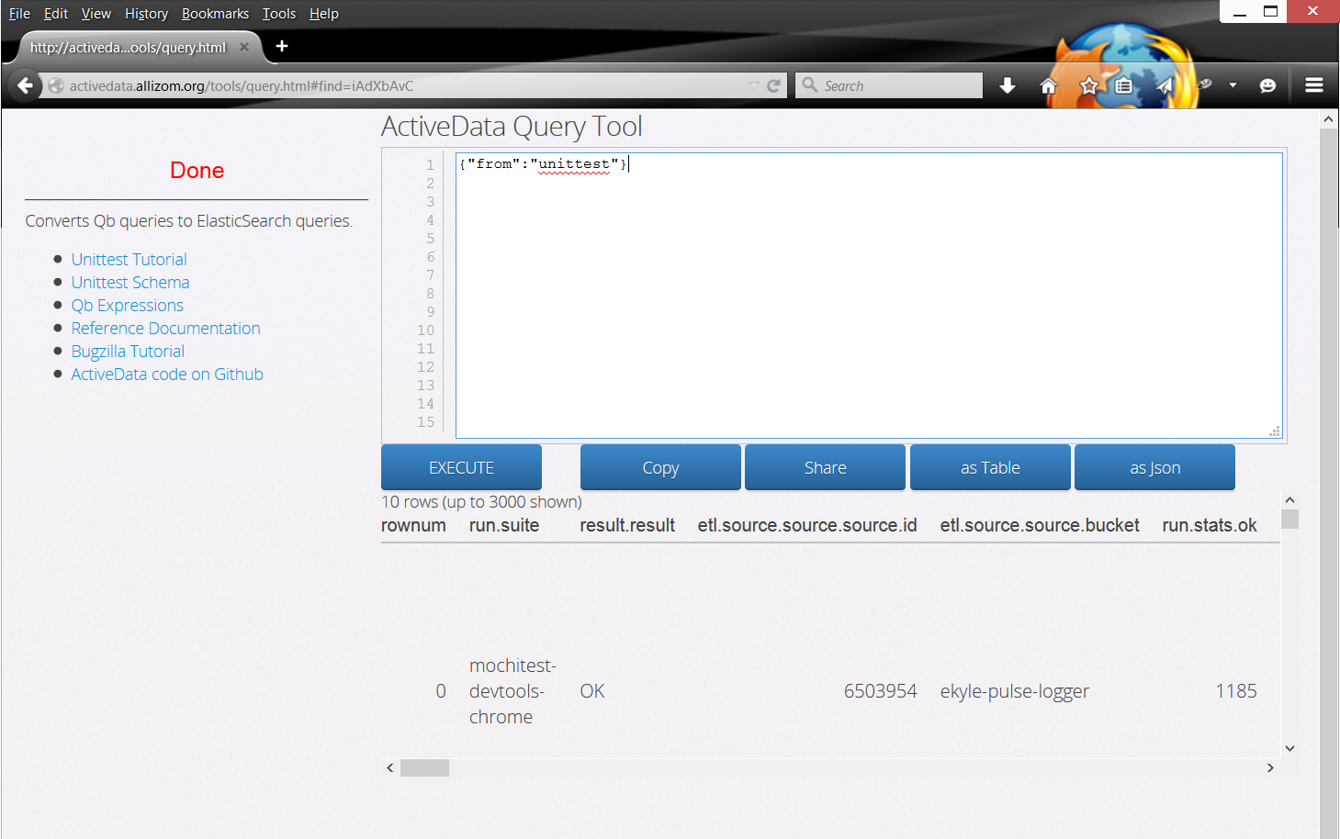
Query Tool
http://activedata.allizom.org/tools/query.html

Slide 2
Query Tool
Helpful links
http://activedata.allizom.org/tools/query.html

Slide 3
Query Tool
Write your query
http://activedata.allizom.org/tools/query.html

Slide 4
Query Tool
Send query to ActiveData service
http://activedata.allizom.org/tools/query.html

Slide 5
Query Tool
View results
http://activedata.allizom.org/tools/query.html

Slide 6
Query Tool
Select results to copy
http://activedata.allizom.org/tools/query.html

Slide 7
Query Tool
URL to retrieve this query
http://activedata.allizom.org/tools/query.html

Slide 8
Query Tool
Format as Table
http://activedata.allizom.org/tools/query.html

Slide 9
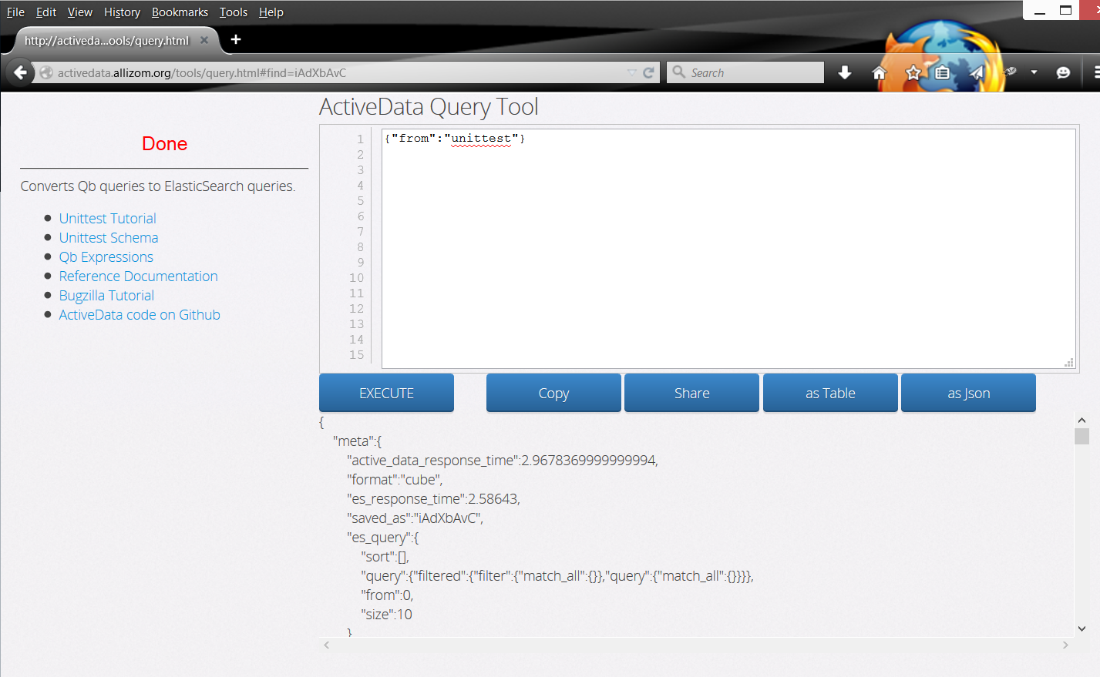
Query Tool
Format as JSON
http://activedata.allizom.org/tools/query.html

